Slide 1
Autotroph |  | Heterotroph
Asexual Reproduction |  | Sexual Reproduction
Asexual Reproduction |  | Sexual Reproduction
Asexual Reproduction |  | Sexual Reproduction

Slide 2
Consumes other organisms for food Has to eat |  | Makes its own food Photosynthesis
Two Parents |  | One Parent
Offspring are genetically diverse |  | Daughter cell is identical to parent cell
Better able to adapt to changes in the environment |  | Genetically identical

Slide 3
Asexual Reproduction |  | By choosing the planet with the most or highest cotton yield
What are the characteristics of Yeast? |  | Explain budding
Which cell components are most involved in determining the shape of your nose? |  | What is one disadvantage of asexual reproduction?
How are genetic variations introduced into the population? |  | Where are genes located?

Slide 4
How can a cotton farmer use selective breeding to increase his cotton production? |  | Less able to adapt to changes in the environment
This is asexual reproduction, A new organism develops from an outgrowth. The new organism is genetically identical to the parent cell |  | Fungi Eukaryotic Asexual Budding
All the member of a population are genetically very similar and less able to survive environmental changes. |  | Genes, DNA chromomosomes, nucleus
On the DNA, on the Chromosome, in the nucleusC |  | Genetic mutations in an organism’s DNA

Slide 5
Crickets who cannot make a sound are less likely to find a mate and reproduce. This is an example of |  | What decides or governs inherited traits?
Genes, chromosome, DNA, nucleus |  | How does a cattleman increase the amount of meat he can sell at the market?
A goat farmer sells the goat’s milk to the cheese maker. How can he increase the milk production? |  | Which of these did not occur as a result of artificial selection? Faster race horses Larger cattle for increased meat production Dogs that can hunt or heard sheep Different beak shapes
What are the characteristics of hydra? |  | What is the advantages of sexual reproduction?

Slide 6
Genetic material in the genes, found on the DNA, on the Chromosome in the nucleus of the cell. |  | Natural selection
By choosing the two cows with the most muscle to breed, selective breeding |  | What are the cell components that decide the markings or spots on a dog?
Beak shapes, such as the birds in the Galapagos finches |  | By breeding goats that are high milk producers
Increased genetic diversity, so more likely to survive environmental changes. |  | Animalia Asexual Consumers - heterotrophs

Slide 7
Asexual Reproduction |  | Asexual Reproduction
Explain the genetic material found in the two new cell that were production through asexual reproduction. |  | Sexual Reproduction
Although the birds on the Galapagos islands are very similar their beaks vary in length. Why are their beaks different? |  | Why do beaks in the same bird species look different?
Black walnut trees produce a nontoxic chemical that becomes highly toxic when it is exposed to air or soil. How does this chemical help the trees compete with plants growing nearby? |  | How would a colorful, detachable tale help a lizard?

Slide 8
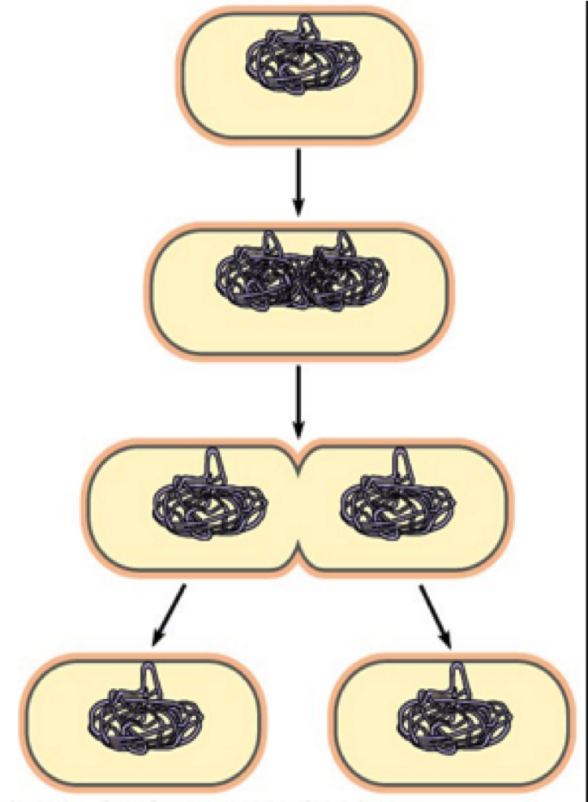
 |  | Genetically uniform
 |  | The genetic material will be identical
Due to the food sources, the bird’s beaks naturally adapted over a period of time. |  | The beak is an adaptation to the food available in the habitat.
Predators are more likely to grab them by the tail. |  | By cutting down on or suppressing the growth of other plants.

Slide 9
How will a short generation time help a species? |  | What are the characteristics of plants?
What are the characteristics of animals? |  | You are at the park and see a shelf-like shape growing from a dead tree. What is it and what are its characteristics.
Characteristics of bacteria |  | Characteristics of Hydra
Explain the offspring of the hydra |  | Botanists, scientist, biologist or vegetarian

Slide 10
Eukaryotic Multicellular Autotrophs/photosynthesis Cell wall |  | They can adapt more quickly to their environment.
Mushroom Fungi Eukaryotic Multi or Uni cellular Absorbs nutrients/heterotroph (absorb nutrients from dead stuff |  | Eukaryotic Multicellular heterotrophs
Animal Eukaryotic Asexual - budding |  | Prokaryotic Asexual Unicellular Autotroph or Heterotroph
Artificial selection Selective breeding |  | The offspring will be genetically identical to the parent

Slide 11
Why is variation in a species important? |  | Explain a variation in birds.
Why would a colorful detachable tail be beneficial to a lizard? |  | Why would a farmer use selective breeding?
What type of selection is mainly used for farm animals, crops and zoo animals? |  | What type of selection is mainly present in wild animals?
How can selective breeding be harmful? |  | What creates variation?

Slide 12
Variations allow birds to get food to survive, such as beak shape and size, talons on feet, claws, they also have hollow bones to make them light. |  | Variation is diversity. Diversity allows organisms to withstand environmental changes.
Grow larger crops To prevent bugs from eating the crops To grow healthier crops |  | The color attracts the predator to the tail. When it is pulled off or eaten the lizard can run away and grow a new tail.
Natural selection |  | Artificial selection Selective breeding
Sexual - The chromosomes that are passed from the parents or a mutation Asexual – A mutation |  | Selective breeding can weed out diversity which means that the organism may not be able to adapt to change.

